Slide 1
SS ZG 526: Distributed Computing
Introduction: Part 1
Chittaranjan Hota
Professor, Dept. of Computer Sc. & Information Systems
BITS, Pilani Hyderabad Campus, Hyderabad
hota@hyderabad.bits-pilani.ac.in

Slide 2
Course Overview
Introduction to distributed computing
Logical time
Global snapshot
Causal ordering of messages in group communication
Distributed mutual exclusion
Consensus and agreement protocols
Distributed deadlock detection
Peer-to-Peer computing
Cluster computing
Grid computing
Internet of Things (IoT)
Birla Institute of Technology and Science, Pilani (Deemed University)

Slide 3

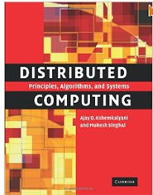
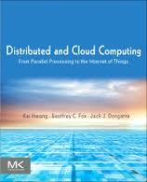
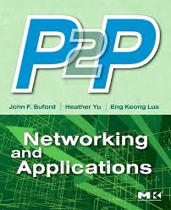
Text and References
T1 | Ajay D. Kshemkalyani, and Mukesh Singhal “Distributed Computing: Principles, Algorithms, and Systems”, Cambridge University Press, 2008 (Reprint 2013).
R1 | Kai Hwang, Geoffrey C. Fox, and Jack J. Dongarra, “Distributed and Cloud Computing: From Parallel processing to the Internet of Things”, Morgan Kaufmann, 2012 Elsevier Inc.
R2 | John F. Buford, Heather Yu, and Eng K. Lua, “P2P Networking and Applications”, Morgan Kaufmann, 2009 Elsevier Inc.
Birla Institute of Technology and Science, Pilani (Deemed University)

Slide 4

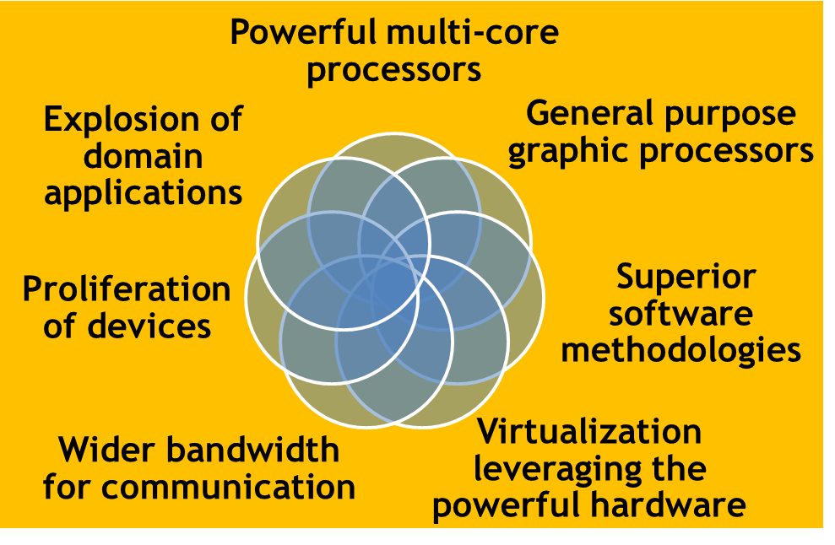
Golden era in Computing
Image source: Cloud Futures 2011, Redmond
Birla Institute of Technology and Science, Pilani (Deemed University)

Slide 5


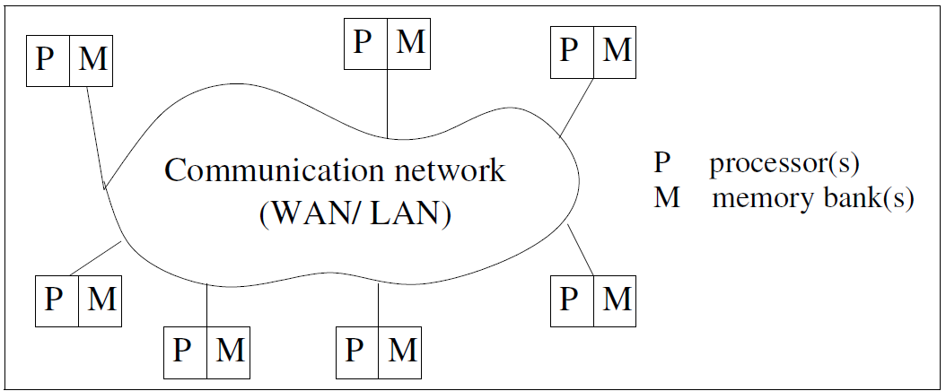
What is a Distributed System?
Loosely coupled collection of autonomous computers connected by a network running a distributed operating system to produce a single integrated computing environment ( a virtual computer).
Birla Institute of Technology and Science, Pilani (Deemed University)

Slide 6

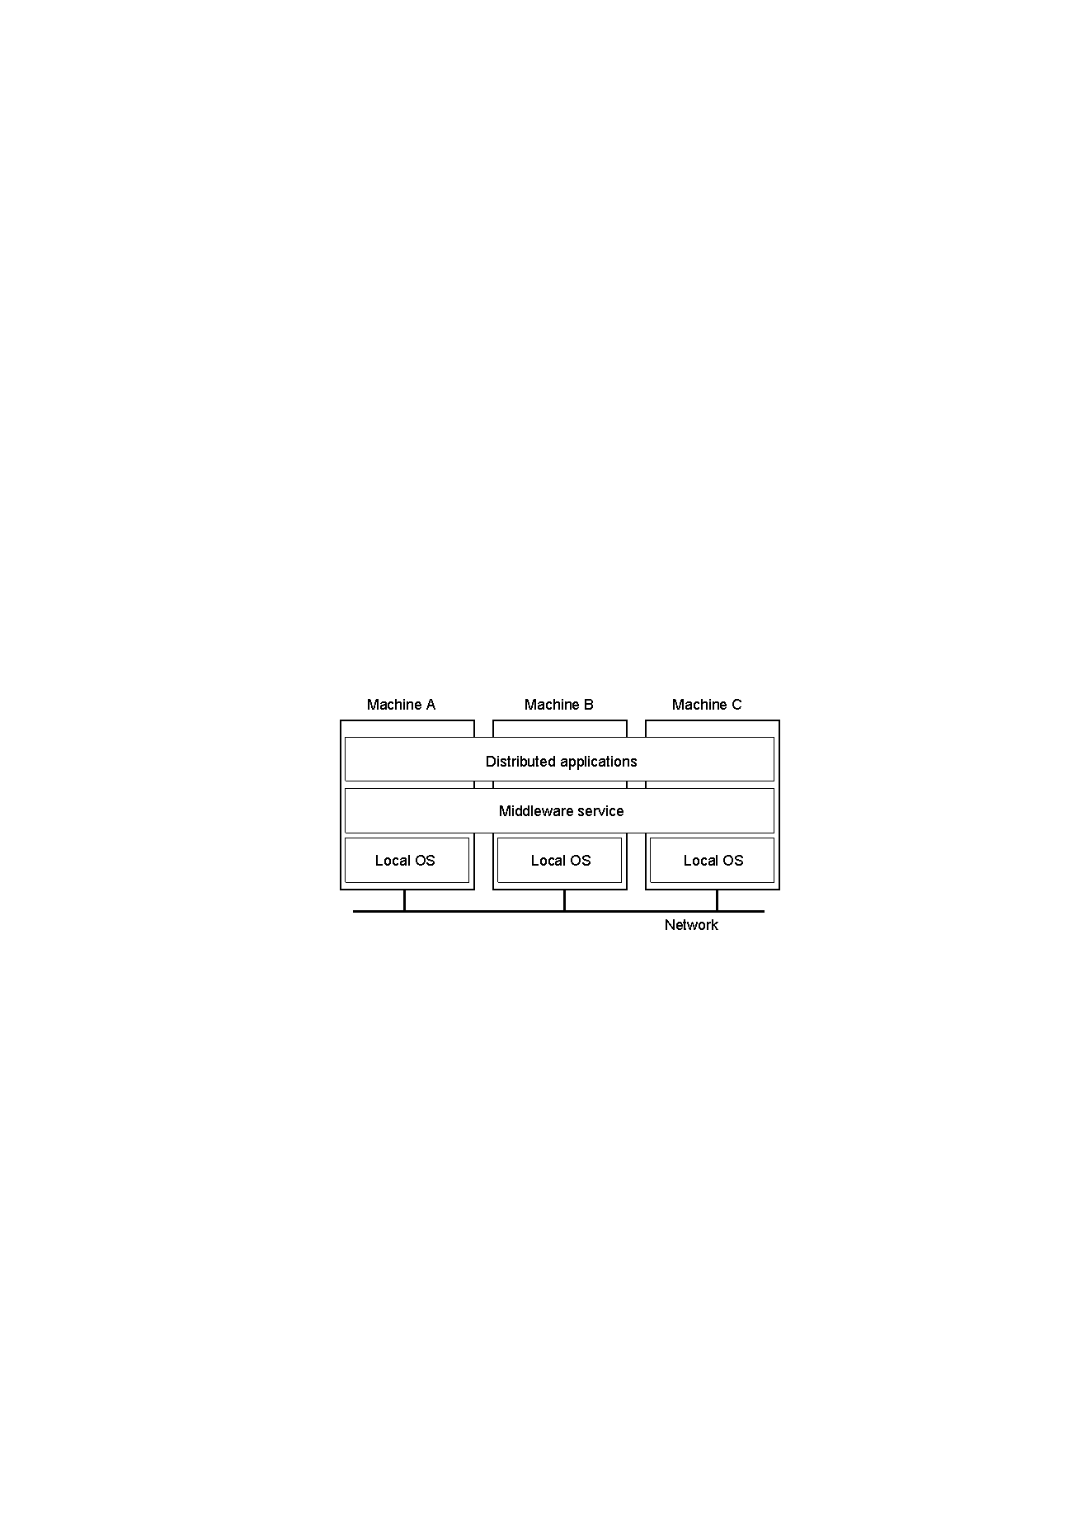
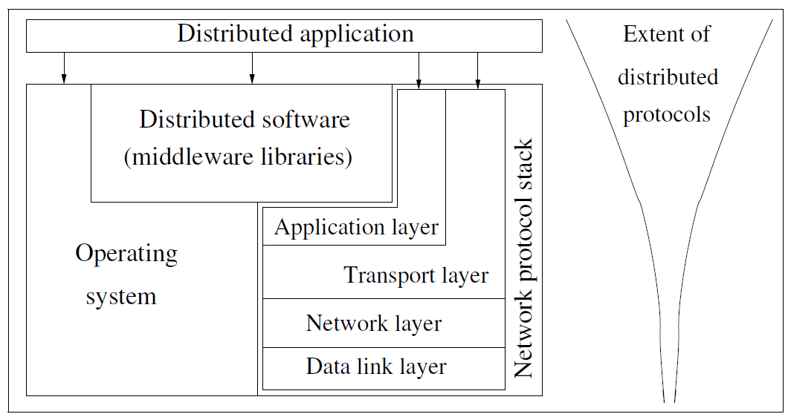
Relation between software components
Birla Institute of Technology and Science, Pilani (Deemed University)

Slide 7
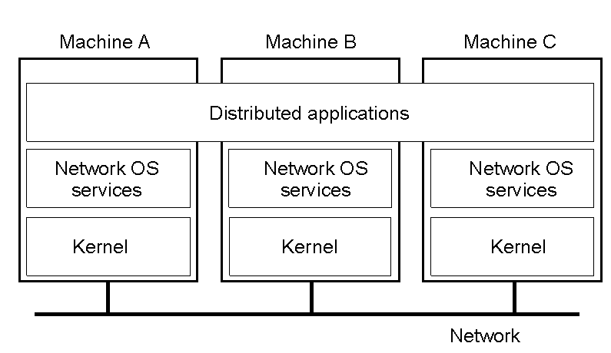
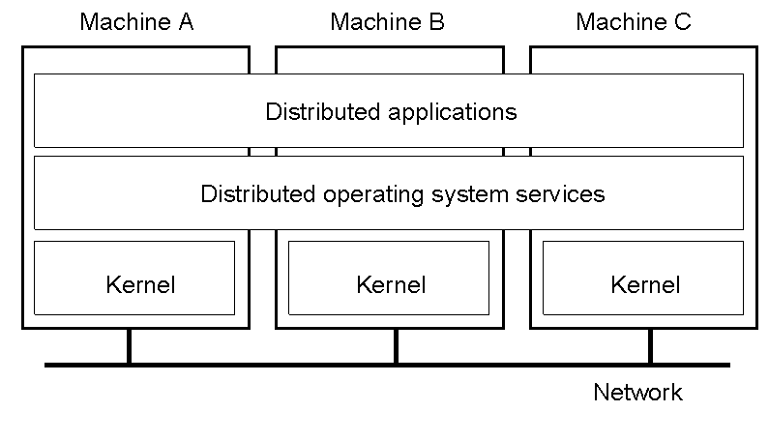

Networked vs. distributed systems
Networking OS
Distributed OS
Birla Institute of Technology and Science, Pilani (Deemed University)

Slide 8

Motivation for Distributed Computing
Resource sharing
Access to remote resources
Increased performance/cost ratio
Reliability
  Availability, integrity, fault-tolerance
Scalability
Modularity and incremental expandability
Birla Institute of Technology and Science, Pilani (Deemed University)

Slide 9

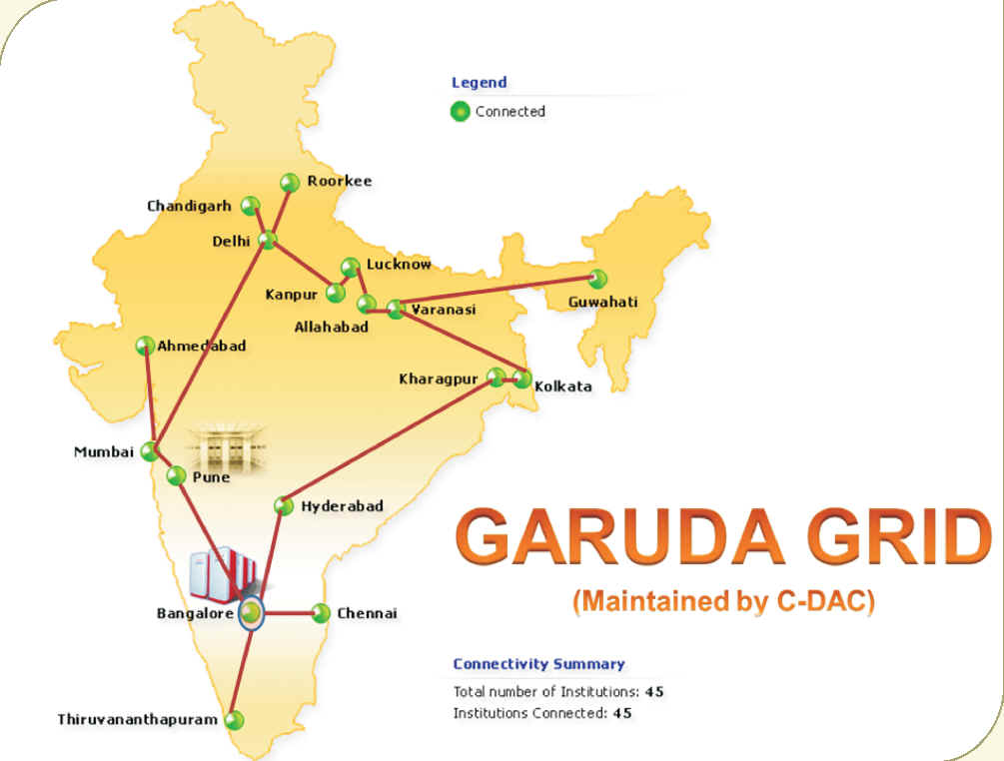
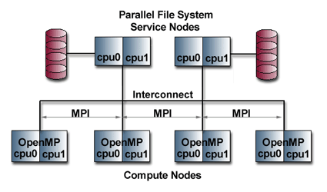
Few Examples …
Linux cluster
Global Access to Resource Using Distributed Architecture
Birla Institute of Technology and Science, Pilani (Deemed University)

Slide 10
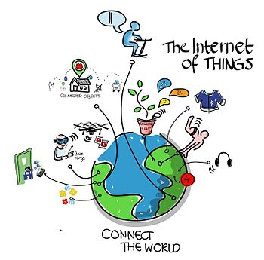
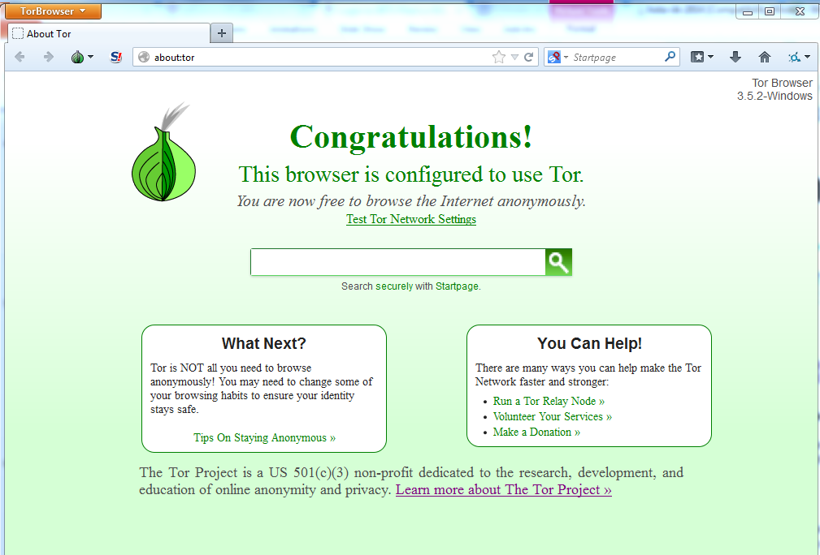

Continued…
Tor P2P Overlay
Image source: Wiki
Birla Institute of Technology and Science, Pilani (Deemed University)

Slide 11
Next session
Multiprocessor vs multicomputer systems, Distributed
systems design issues
Birla Institute of Technology and Science, Pilani (Deemed University)

